Slide 1
BIFX 503: Statistics for Bioinformatics
Instructor: Jennifer Schroeder, Ph.D.
Wednesdays, 5:30-8:00pm
Hodson Technology Center, Room 237
Fall 2021

Slide 2
Inferences About Means
Estimation
Hypothesis testing
t Tests

Slide 3
Statistics, Parameters, and Estimation
Statistics are numbers that are calculated to summarize the sample data, and assumed to estimate the population
Mean, standard deviation
Parameters are numbers that describe the population
μ, σ
We use statistics to estimate parameters

Slide 4
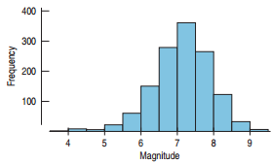
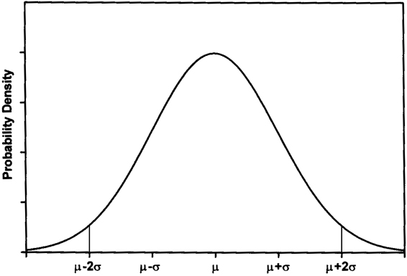
The Normal Distribution
The Normal Distribution is a theoretical model we apply to real data and quantities derived from that data
The x axis is the range of possible outcomes
The y axis is the probability of each outcome

Slide 5
The Normal Distribution
The shape of the Normal distribution is described by two parameters:
The mean, μ, where the distribution is centered
The standard deviation, 𝞂, the degree of spread

Slide 6
Population vs. Sample
There are many different possible samples that could be drawn from a population, each of which could have different characteristics (e.g., different sample means).
There is a true population mean that we are approximating with the sample means.

Slide 7
Sampling Distribution
Consider all possible samples of size 20 that we could have used to estimate the population mean (student weight)
If we generated a histogram of all of these sample means, this is the sampling distribution
A sampling distribution is the distribution of sample statistics from all possible samples of the same sample size
Notes:
Difference between Sampling Distribution and Sample Distribution? Midterm question.

Slide 8
What does the sampling distribution tell us?
The sampling distribution allows us to make statements about what the population parameter is, and how well we estimated it
The mean of the sampling distribution is our estimate of the population parameter
The standard deviation or variance of the sampling distribution shows the precision of our estimate of the population parameter

Slide 9
Sample Distribution vs. Sampling Distribution
Note the distinction!
A sample distribution shows how the measured data are distributed
E.g., histogram of blood pressure in a single sample having n=50
A sampling distribution shows how a calculated statistic is distributed
E.g. histogram of mean blood pressure generated from a 100 samples each with n=50

Slide 10
Inferences About Means
Calculate a confidence interval for the mean
Puts boundaries on likely values for the mean
Perform hypothesis tests on the mean
Is our sample mean different from some value
Both should be done when analyzing data

Slide 11
Confidence Intervals

Slide 12
Sampling Distribution for a Mean
When a random sample of size n is drawn from a population with mean μ and standard deviation σ, the sampling distribution has:
Mean: μ
Standard Deviation:
For large sample size, the distribution is approximately normal regardless of the population the random sample comes from
The larger the sample size, the closer to normal
a.k.a. Standard Error of the Mean, or SEM

Slide 13
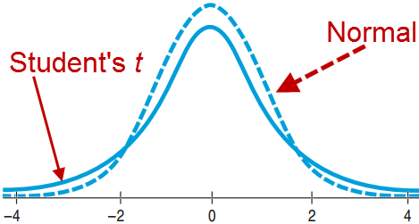
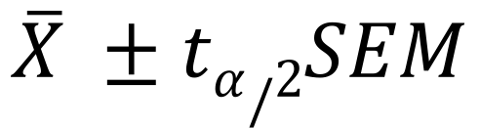
Confidence Limits for the Mean
$$\overline{X} ±tα/2SEM$$
Where t_{α/2} is the value on the x axis of the t distribution where (1-α)% of the area falls between these boundaries on either side of the mean
t distribution depends on degrees of freedom (df=n-1)

Slide 14
The t Distribution
Bell shaped, like Normal
Slightly different distribution for each sample size
Degrees of Freedom
df = n-1

Slide 15
Interpreting Confidence Intervals
The confidence interval reflects the degree of certainty with which you have estimated the population mean with your sample mean
A 95% CI means that if you drew many independent samples of size n and calculated a 95% CI for each of them, the population mean will be included in these intervals 95% of the time

Slide 16
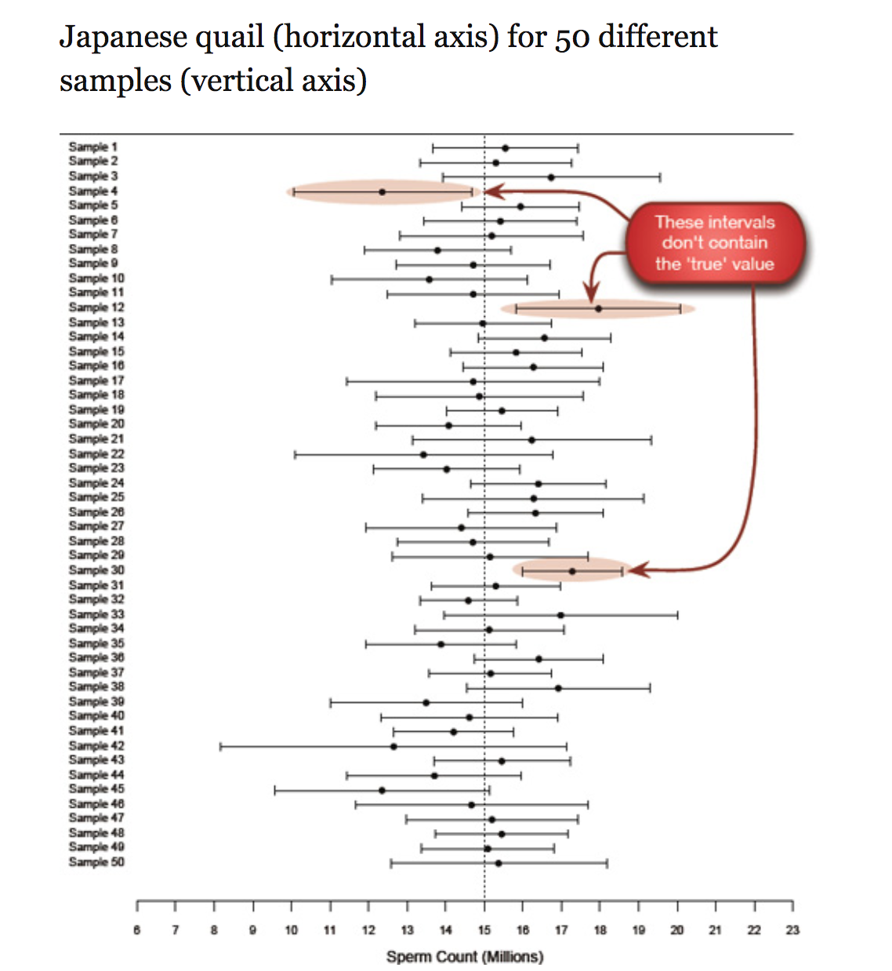
From Field et al., Discovering Statistics Using R, Sage Publications Ltd., 2012.

Slide 17
Calculating Confidence Intervals in R
Can program the formula
Easier way: function CI() in library Rmisc
CI(variable, ci=level) where level is the level of confidence, e.g. 0.95
CI(cats$Bwt, ci=0.95)
95% CI for body weight = (2.64, 2.80)
Interpretation: if many independent samples of size n=144 were drawn, the population mean would be included in this interval 95% of the time

Slide 18
Confidence Intervals for Groups
It can be useful to compare the CI’s for subgroups, e.g. male and female cats
If the CI’s overlap, this is evidence that the groups are not substantively different
First, create the subsets you want to compare
Then calculate the CI separately for each

Slide 19
Confidence Interval Comparison
R cats dataset
47 female and 97 male cats used for digitalis experiments
Body weight (kg) and heart weight (g)
Do male and female cats differ in terms of body weight?

Slide 20
Confidence Interval Comparison
Create subsets:
cats_female <- cats[cats$Sex == "F",]
cats_male <- cats[cats$Sex == "M",]
CI(cats_female$Bwt)
upper mean lower
2.440020 2.359574 2.279129
CI(cats_male$Bwt)
upper mean lower
2.994219 2.900000 2.805781
Upper bound for females is lower than lower bound for males – evidence that groups are different
Though not a formal hypothesis test

Slide 21
Hypothesis Testing

Slide 22
What’s a Hypothesis?
A proposed explanation for a phenomenon
A tentative, testable answer to a scientific question
Does a new drug reduce cholesterol?
In statistical hypothesis testing:
There is an “alternative” and a “null” hypothesis
Hypotheses can be one- or two-sided

Slide 23
Alternative and Null Hypotheses
The null hypothesis typically means the status quo
No change, no difference
H₀: the new drug did not reduce cholesterol
The alternative hypothesis is the opposite
Things did change, there is a difference
H_{A}: the new drug did reduce cholesterol
This is the hypothesis you are interested in showing is true

Slide 24
One- and Two-Sided Hypotheses
A two-sided hypothesis has no direction
You are interested only in whether something changed, not how it changed
Has weight changed as the result of diet
A one-sided hypothesis is more specific
Has weight decreased as the result of diet
Has strength increased as the result of new exercise equipment

Slide 25
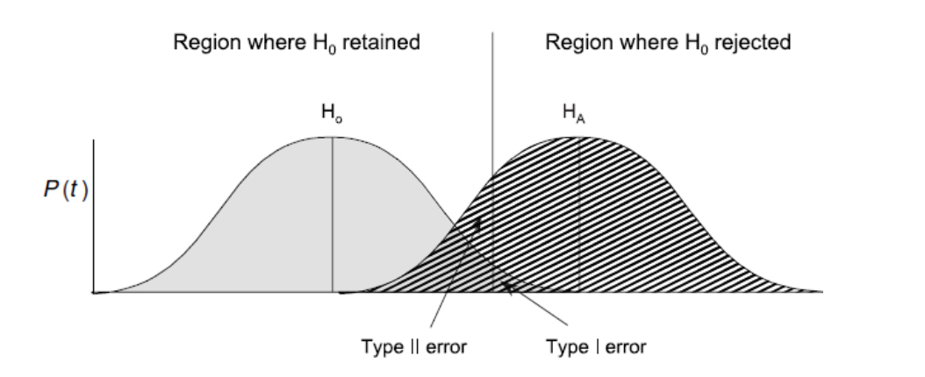
Hypothesis Testing
The idea is that some unknown probability function generated your data.
You propose two candidate distributions and determine which is more likely, based on your data.

Slide 26
Analogy: Jury Trial vs. Hypothesis Testing*
Jury Trial
Hypothesis Testing
Assume innocent until proven guilty
Base conclusions only on evidence presented in trial
Think about whether the evidence is consistent with the assumption of innocence
If not, reject the assumption of innocence and declare the defendant to be guilty
Assume null hypothesis is true
Base conclusions only on data from one experiment
Determine whether the data is consistent with the assumption of the null hypothesis
Test statistic, p value
If not, reject the null hypothesis and conclude an effect exists
*Adapted from Motulsky, Intuitive Biostatistics, Oxford University Press 1995.

Slide 27
Classical Statistical Hypothesis Testing
Frequentist philosophy
First, propose two competing hypotheses
Null (H₀) and Alternative (H_{A})
Second, choose the correct statistical test
E.g., z, t, F, chi square
Calculate the test statistic and p value
P value is the the probability that that test statistic or something more extreme if H₀ is true
Choose between the hypotheses, based on the evidence in the data: Reject or do not reject H₀

Slide 28
The P-value
At first you assume the null hypothesis is true (no effect exists).
You calculate the probability of observing your results or something more extreme if the null hypothesis is true – this is called a p value.
If this probability is very small,
your data were unlikely to be observed if the null hypothesis were true
the alternative hypothesis is a better fit with your data.

Slide 29
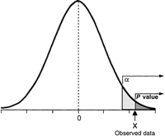
Significance Level
How small does this probability need to be in order to conclude that the null hypothesis does not fit the data?
This is called the significance level, or alpha, or the Type I error rate.
When the p-value is less than alpha, the result is called “statistically significant”
It is convention to set the significance level at 0.05
5% false positive rate

Slide 30
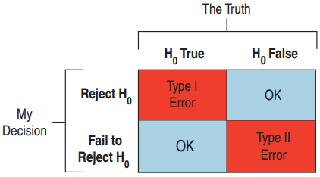
Type I and Type II Errors
Type I error: False Positive
Conclude change happened when it did not
P(Type I error) = α
Type II error: False Negative
Conclude nothing happened when it actually did
P(Type II error) = β

Slide 31
Alpha
Alpha is the Type I error rate (false positive rate)
Probability of erroneously concluding that an effect is present, given many replications of the same experiment/test
Controls error in the long run
Represents the “standard of proof” that the phenomenon under study exists
Lower alpha ↔ less likely to mistake a chance finding for a real association

Slide 32
Statistical Power
Statistical power is the probability that a study will detect an effect when there is an effect to be detected
1-β

Slide 33
What Affects Power
The size of the effect
Bigger effects are easier to find
The sample size
Higher sample size leads to more precise parameter estimates (smaller SEM)
The sample variability
Smaller variance → smaller SEM
Alpha
Smaller alpha → more conservative test → less power

Slide 34
Inconclusive Findings
You can never “prove” that the null hypothesis is true!
You can only reject it or fail to reject it
Rejection of H₀ means that there is enough evidence in the data to reject it
Failure to reject H₀ means there is not enough evidence in this dataset
Further study may be necessary …

Slide 35
t Tests

Slide 36
t Tests
Comparing means
One sample
Does a sample mean differ from some benchmark value?
Independent sample
Do means from two independent samples differ?
Paired
Do means from two dependent samples differ?

Slide 37
t Tests
Comparing means
One sample
Independent samples
Paired
H₀: μ = μ₀
H_{A}: μ ≠ μ₀
H₀: μ_{A} = μ_{B}
H_{A}: μ_{A} ≠ μ_{B}
H₀: μ_{d} = 0
H_{A}: μ_{d} ≠ 0

Slide 38
One Sample t Test
Goal is to compare a sample mean to a known value
Example: is the mean body temperature of a sample of intertidal crabs different from the ambient air temperature (24.3℃)?
H₀: μ = μ₀
H_{A}: μ ≠ μ₀

Slide 39
Independent Samples t test
Goal is to compare means from two independent samples
Example:
Male adult rabbits are divided randomly into two groups
Each group is given a different drug
Do the drugs affect clotting time?
H₀: μ_{A} = μ_{B}
H_{A}: μ_{A} ≠ μ_{B}

Slide 40
Independent Samples t test
Two versions:
Samples have equal variances
Samples have unequal variances
One approach: first, test the hypothesis that sample variances are equal to know which version of the t test to use
Alternative: always use the unequal variances version, because you can’t prove that the variances are equal ☺

Slide 41
Independent Samples t Test
Compare the calculated test statistic to the t_{n-1} distribution
P-value is the total area under the curve toward the tail(s)
One-sided hypothesis test: one tail
Two-sided hypothesis test: two tails summed
If p < alpha, reject H₀, conclude sample mean is different from μ₀

Slide 42
Independent Samples t Test in R
t.test(variable ~ group, data)
Variable refers to the variable you want to test
Group defines the different groups
Data is the dataframe the variables are in
var.equal specifies which version of the test to do
Default is unequal variances, only need to specify if they are equal

Slide 43
Example: Independent Samples t Test
R cats dataset
47 female and 97 male cats used for digitalis experiments
Body weight (kg) and heart weight (g)
Do male and female cats differ in terms of body weight or heart weight?

Slide 44
Assumptions for Independent Samples t Tests
Independence: between and within groups
Random samples are evidence of independence
Nearly Normal distribution
Must be checked for both groups
n < 15: must be very close to normal
15 ≤ n ≤ 40: check for outliers and skewness
n > 40: fine as long as no extreme outliers or extreme skewness

Slide 45
Class Exercise: Independent Samples t Test
R crabs dataset
200 crabs, 50 of each sex and species combination
Male/female
Blue/orange
Morphological measurements (mm)
Frontal lobe size, rear width, carapace length, carapace width, body depth
Use two-sample t tests to determine if any morphological measurements differ by sex or by species

Slide 46
Paired Samples
Previously we were interested in comparing the means of two independent samples
What if the samples are not independent?
Examples:
Weight before and after a diet
Height of father and adult son

Slide 47
How Paired Samples Are Different
The paired nature of the data means that there are dependencies (correlations) among in the measurements in a pair that unpaired data do not have
The assumption of independence that the unpaired techniques rest on has been violated
Methods for unpaired data ignore this correlation and can lead to incorrect conclusions when used on paired data

Slide 48
When to Use Techniques for Paired Data
Techniques for paired data are necessary whenever the value for one subject in the pair is expected to be more similar to the other subject in the pair than to that of a randomly selected subject outside the pair

Slide 49
When to Use Techniques for Paired Data
Before – after measurements on the same individual
A measurement is made on siblings or parent/child pairs
You use a matched study design, in which each subject has a matched control
E.g. participants in a clinical trial of a drug are matched on age, gender, and clinical condition; each member of the pair receives a different treatment (e.g., randomized to active drug or placebo)

Slide 50
Paired Samples
When data are paired, it is the difference between the two elements of the pair that we are interested in, e.g.:
Change in weight (post – pre)
Difference in height (father – son)

Slide 51
Paired t Test
Goal is to compare means from two samples that are not independent
Example: Are the lengths of the left hindleg and left foreleg equal in deer?
H₀: μ_{d} = 0
H_{A}: μ_{d} ≠ 0

Slide 52
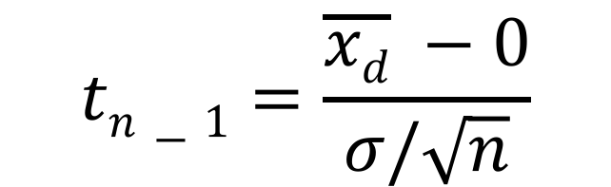
Paired t Test
Test statistic
Test statistic will be bigger if:
Difference (numerator) is larger
Denominator is smaller
SD is smaller (tighter distribution)
Sample size is larger
$$tn−1=\frac{\overline{xd} −0}{σ/\sqrt{n}}$$

Slide 53
Paired t Test
Compare the calculated test statistic to the t_{n-1} distribution
P-value is the total area under the curve toward the tail(s)
One-sided hypothesis test: one tail
Two-sided hypothesis test: two tails summed
If p < alpha, reject H₀, conclude sample mean is different from μ₀

Slide 54
Paired t Test in R
t.test(variable ~ group, data, paired = TRUE)
Variable refers to the variable you want to test
Group defines the different groups
Data is the dataframe the variables are in
Can run the test on only a subset of the data
t.test(variable~group, data, paired=TRUE, subset = subvar == value)

Slide 55
Example 1: Paired t Test
Data set ZeaMays from HistData package
Growth of corn seedlings
Plants otherwise grown under identical conditions
Height of plants (inches)
Taller plants more vigorous
Hypothesis: cross-fertilized plants more vigorous than self-fertilized plants
One-sided test
t.test(ZeaMays$diff, mu=0, alternative=“greater”)
H₀: μ_{d} = 0
H_{A}: μ_{d} > 0

Slide 56
Example 2: Paired t Test
Data set sleep
The effect of two soporific drugs to increase hours of sleep
10 patients given both drugs
Perform paired t test to see if mean extra sleep differs for the two drugs
t.test(extra ~ group, sleep, paired = TRUE)

Slide 57
Assumptions for Paired t Test
Paired data
Independence: of the differences
Random sample
Nearly Normal
The differences must follow a nearly normal distribution
Check with a histogram

Slide 58
Class Exercise: Paired t Test
R dataset Rabbit
Five rabbits were studied on two occasions
Given 5-HT_3 antagonist MDL 7222 or Control
Given ascending doses of phenylbiguanide
Blood pressure measured after each dose
For which dose(s) of phenylbiguanide is there a difference between the test treatment and the control?
Hint: use the subset argument in t.test()

Slide 59
The Central Limit Theorem

Slide 60
The Central Limit Theorem
When testing hypotheses, it’s not the distribution of the data that matters so much as the sampling distribution of the parameter you’re estimating
The sampling distribution of any mean becomes nearly Normal as the sample size grows
Requirements:
Independent observations
Randomly collected sample

Slide 61
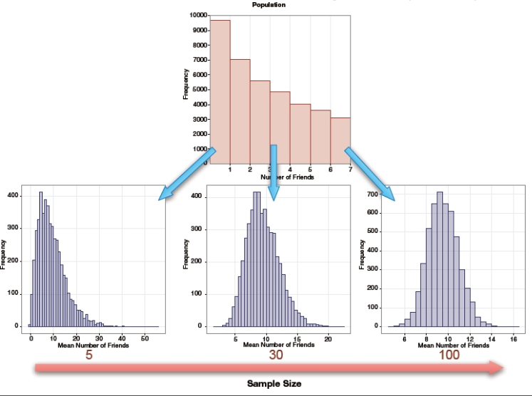

Slide 62
Application of the Central Limit Theorem
If the sample size is sufficiently large, the sample mean will be approximately normally distributed even if the underlying sample data are not.
Why is this so important? Most distributions encountered in the real world are not normal, but we can still estimate the sample mean and make inferences about it using the properties of the normal distribution, provided n is sufficiently large.

Slide 63
Non-Parametric Alternatives

Slide 64
Non-parametric Alternatives
Analysis | Normal method | Non-parametric alternative
Compare two independent samples | Two-sample t test | Wilcoxon rank-sum test Mann-Whitney test
Compare two dependent samples | Paired t test | Wilcoxon signed-rank test
Wilcoxon rank sum test
wilcox.test(variable ~ group, data)
Wilcoxon signed rank test
wilcox.test(variable ~ group, data, paired=TRUE)

Slide 65
Why Use Non-Parametric Methods?
Many methods depend on the assumption that data is normally distributed
What to do if it’s not?
Deviations from normality are particularly important when the sample size is small
CLT is in effect for large sample sizes
In some cases, non-parametric methods are the best choice
Called non-parametric because there are no distributional assumptions
No distributional parameters to estimate

Slide 66
Non-Parametric Methods
Many of these methods rely on ranking the data values and using these ranks for analysis instead of the original measurements
Using ranks solves the problems of outliers and skewness

Slide 67
Class Exercise: Non-Parametrics
Assess whether the data appear normal (use box plots) and re-analyze the independent samples and paired samples problems using non-parametric methods
Cat body weight
Sleep data
Do your conclusions differ from the parametric methods? Why or why not?

